Slide 1
Transforms

Slide 2
Transforms
Provide option for changing the appearance of elements
Two-dimensional
Three-dimensional

Slide 3
2D Transform Options
Options
translate
rotate
scale
skew
matrix

Slide 4


translate
transform:translate(x, y);
move x pixels to the left/right and y pixel up/down
transform:translate(100, 75);

Slide 5

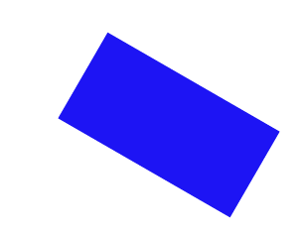
rotate
transform:rotate(deg);
Rotate/”spin” the element a certain number of degrees
transform:rotate(30deg);

Slide 6


scale
transform:scale(width, height);
Change the width and height of the element
transform:scale(2,3);

Slide 7

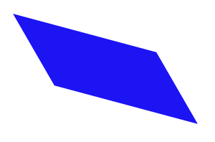
skew
transform:skew(x-angle, y-angle);
Rotate the element a certain number of degrees along the x and y axis
transform:skew(30deg, 15deg)

Slide 8
matrix
matrix() - combines all of the 2D transform methods into one

Slide 9
3D rotate
You can rotate along the x, y, or z dimension along a given degree
transform:rotateY(deg)
transform:rotateX(deg)
transform:rotateZ(deg)
transform:rotate3d(x, y, z)

Slide 10
Others
3D scale
3D translate

Slide 11
Review
Transforms are one more way to modify the look of your page.
Often combined with state changes
Will typically require browser prefixes.

Slide 12

Acknowledgements/Contributions
These slides are Copyright 2015- Colleen van Lent as part of http://www.intro-webdesign.com/ and made available under a Creative Commons Attribution-NonCommercial 4.0 License. Please maintain this last slide in all copies of the document to comply with the attribution requirements of the license. If you make a change, feel free to add your name and organization to the list of contributors on this page as you republish the materials.
Initial Development: Colleen van Lent , University of Michigan School of Information

